Slide 1
CSC 200 Class 10
Theory of Computation
Computer Scaling

Slide 2
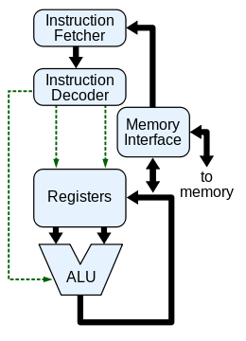
The CPU
Just a quick reminder that the brain of the computer is the central processing unit.
Read memory in from the right
Store things in the registers
Do math on the registers
Do it all really fast

Slide 3
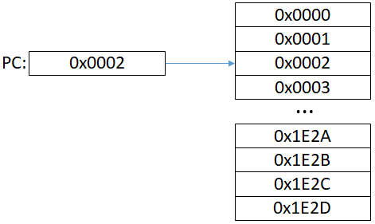
More detail
The program counter is a special register which points to the current program instruction.
Each instruction tells the CPU to do something with register data.
Jump instructions tell the program where to go next.
Probably the next instruction 0x0003.
Maybe elsewhere in the program.
This is how if, for, and while work.
A <op> B => D
If <condition>
Jump to Address

Slide 4

Computational Process
The PC points to memory 0x000 for the first instruction.
The instruction is loaded to the decoder.
The registers A & C are subtracted.
The answer is put into D
The PC moves to 0x0001
Registers
Memory
PC:
0x0000
0000
0x0000
0001
A:
0002
0x0001
0002
B:
0000
0x0002
C:
0004
0x0003
0004
D:
0002
0x0004
0000
Decoder
0000
0002

Slide 5
Computational Process
Data is loaded from 0x0002 to C.
PC advances to 0x0003.
The instruction is loaded to the decoder.
The registers C & D are subtracted.
The answer is put into D
Registers
Memory
PC:
0001
0x0000
0003
A:
0002
0x0001
B:
0000
0x0002
0x0002
C:
0008
0x0003
0004
0x0003
0008
D:
0006
0x0004
0002
0002
Decoder
0000
0006

Slide 6
Computational Process
The PC moves to 0x0004
The value of D is written to 0xFE2B
Registers
Memory
PC:
0004
0x0000
A:
0002
0x0001
B:
0000
0x0002
C:
0008
0x0003
D:
0006
0x0004
0006
Decoder
0000

Slide 7
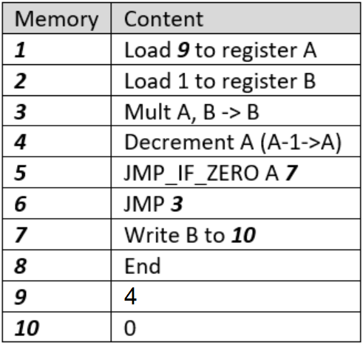
Practice Exercise 2 – 15 Minutes
Sit in a group of 2-3 people.
Draw a three register system on paper.
PC
A
B
Execute this program on paper

Slide 8
Scaling

Slide 9
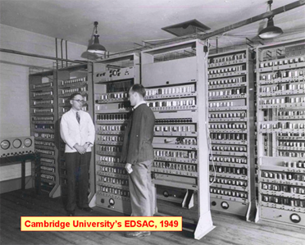
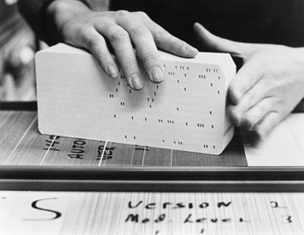
What is Scaling?
In the old days there was one computer which ran all programs for a whole university or company.
People had to wait for the computer to be available.
The time it took to load and run a computer was the big waste of time.
This paradigm worked for <10 programmers, but not at all for 10,000. The solution didn’t scale well.

Slide 10
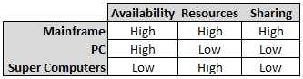
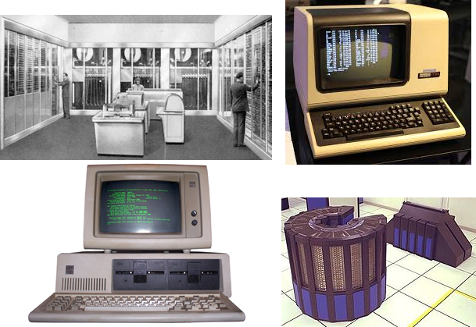
Evolution of Scalable Computing
Mainframes with separate terminals worked well for developers working independently, but resources were shared.
Terminals had no resources, but could push processes to the mainframe.
Personal computers gave each developer his own limited resources.
Supercomputers had more resources with less availability.
Collaboration in a networked environment made all of these unsuitable.

Slide 11
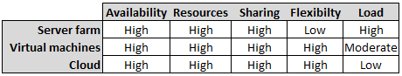
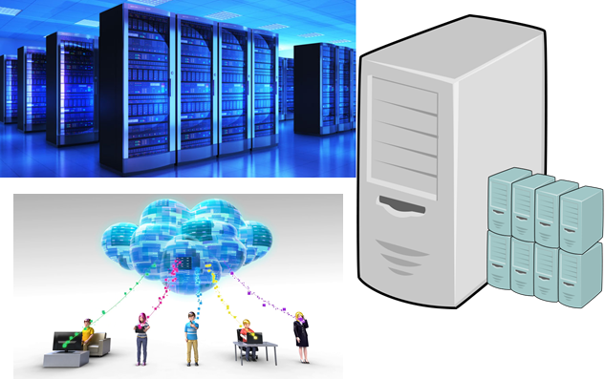
Evolution of Scalable Computing (2)
Server clusters provide lots of resources in modular units.
Virtual machines provide even more flexibility in resource utilization.
Mobile devices have very limited resources, pushing more processing to the cloud.

Slide 12
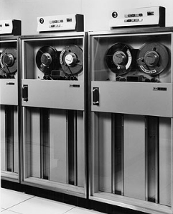
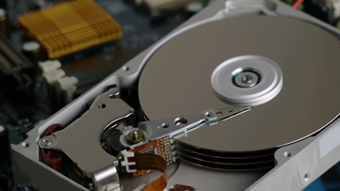
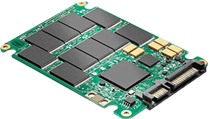
Effect on Memory
Magnetic Tape
Slow access
Easily damaged
Spinning Media
Expensive
Breakable
Solid-state Media
Inexpensive
No moving parts
Physical device

Slide 13
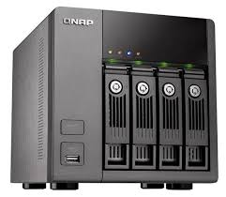
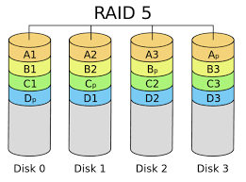
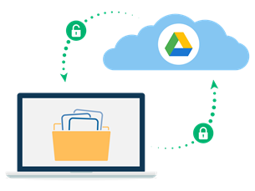
Effect on Memory (2)
Network Attached Media
Fixed location
Agnostic implementation
Backup/duplication
Web-drives
Unknown location
Secure
High availability/reliability

Slide 14
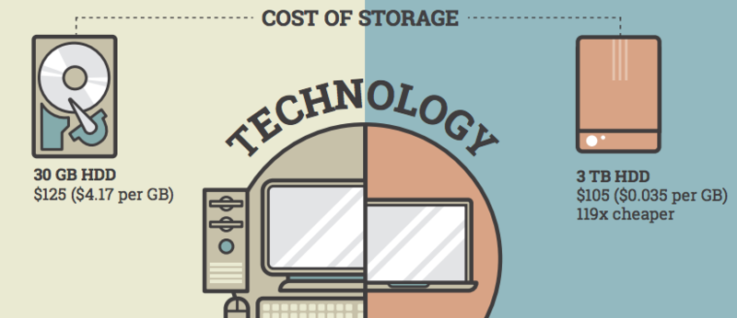
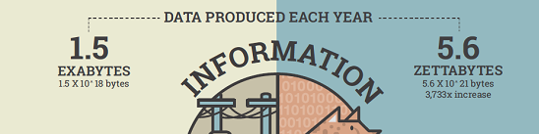
How Much Data Can Be Made/Stored
In case you think of “normal” data storage needs, that number is changing all the time.
1980 – Why would I need to store more than one document on a disk?
2020 – Why wouldn’t I need to store all 8 seasons of “Game of Thrones”?
Storage is getting cheaper, but data production is getting faster.

Slide 15
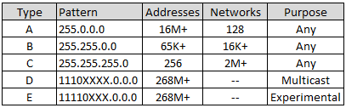
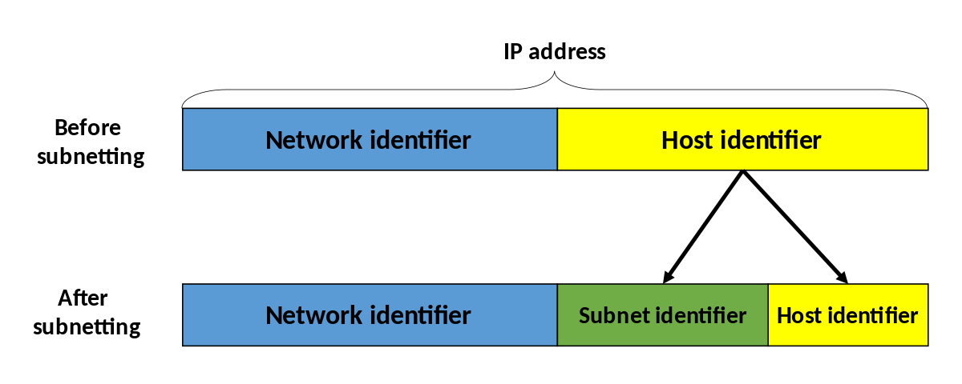
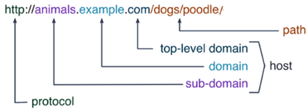
Effect on Networking
Networks originally came in fixed sizes.
These sizes were too inflexible.
Not enough small networks.
No intermediate sizes
Sub-netting provided complete flexibility.
Domain mapping allows additional network divisions behind the subnet.

Slide 16
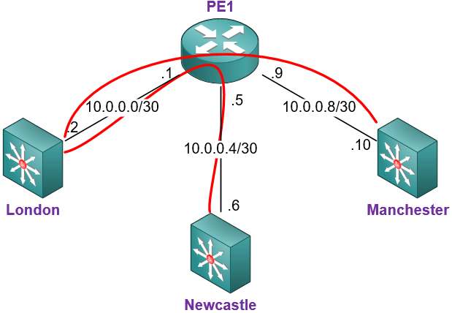
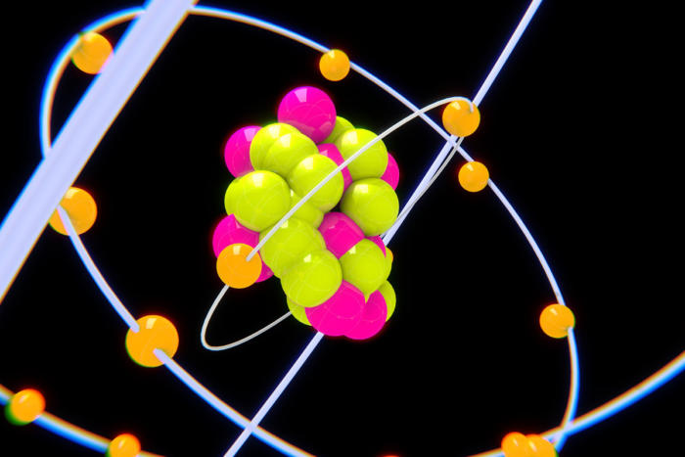
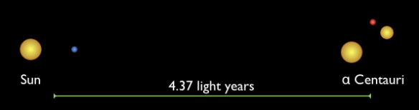
Effect on Networking (2)
Routing allows local networks to be hidden.
IPv4 had 2³²≈4.3 Billion addresses for 7 Billion people.
Internet of Things reached more devices than people ~2010.
IPV6 will provide 2¹²⁸≈3,400 Billion Billion Billion addresses.
1 Proton = IPv4
Distance to Alpha Centauri < IPv6

Slide 17
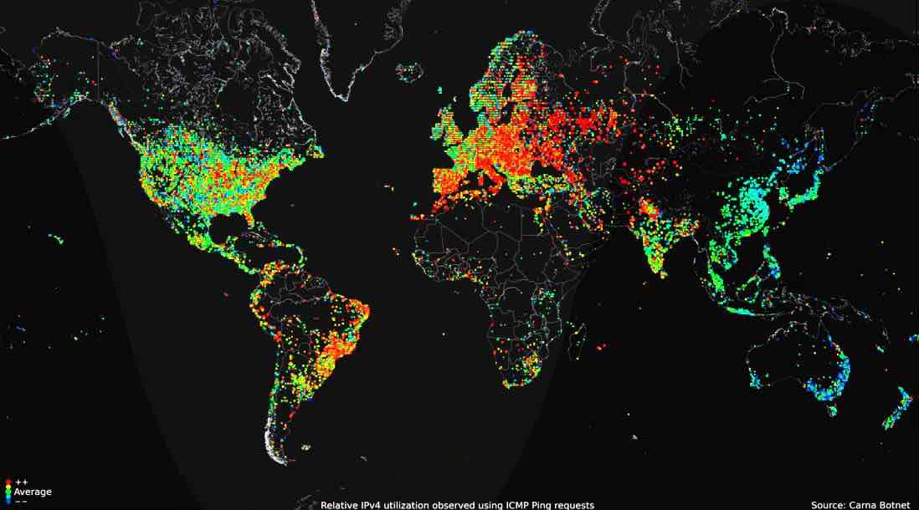
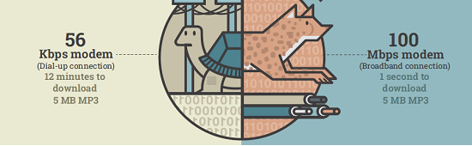
How Much Data Can Be Sent?
This map shows the relative number of internet connections for the whole world.
Red high – Blue low
The demand for data over the internet is growing.
Internet content is starting to exceed internet capacity.
Who pays for you to stream Avengers: End Game?

Slide 18
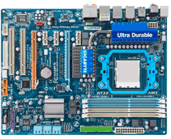
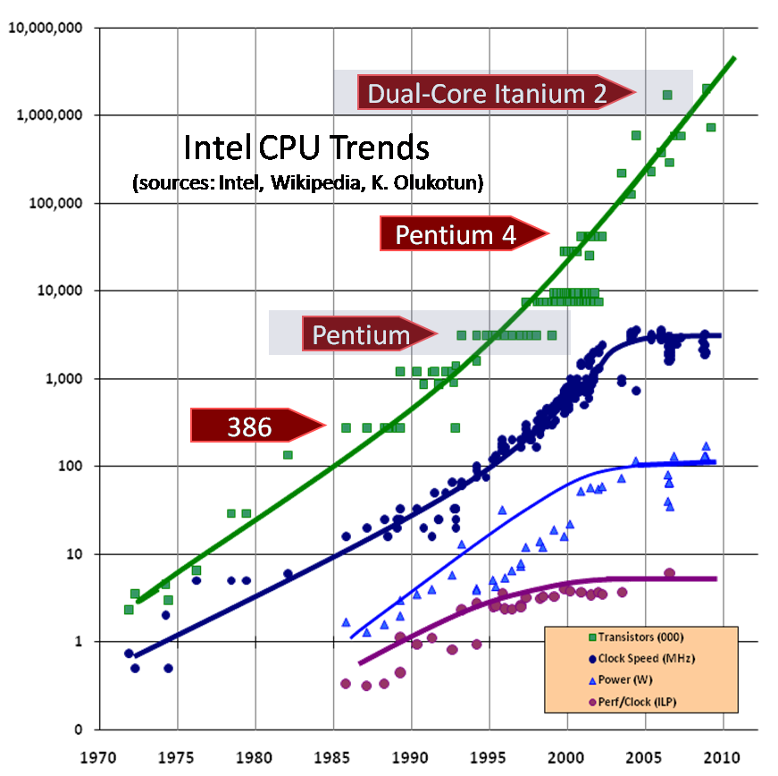
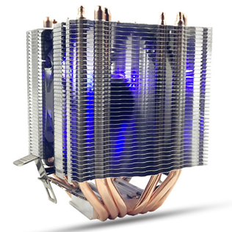
Effect on Processors
CPUs were designed to do one job at a time.
Timesharing and multitasking allowed more jobs to run in human time.
Processors got smaller and faster until heat dissipation became a problem ~2005.

Slide 19
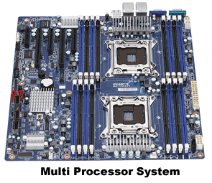
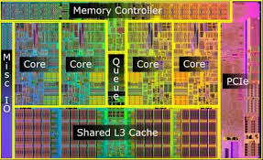
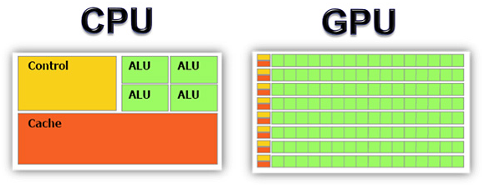
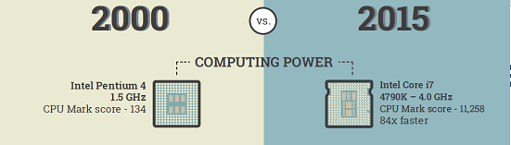
Effect on Processors (2)
Multiple processors could do more at the same time with added coordination problems.
Multi-core processors could do more on the same processor.
Graphics Processor Units have much greater capabilities in a limited space.
Programming for these processors is difficult.
The combination of more processors, more cores, and timesharing allows VMs to achieve more.

Slide 20
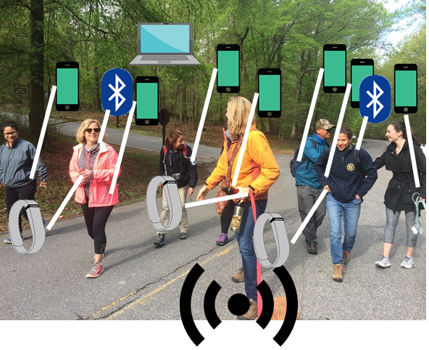

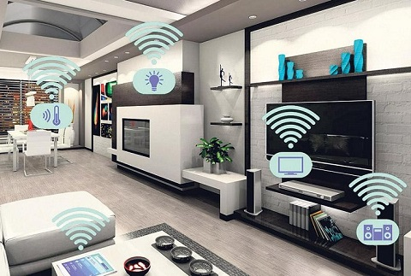
Internet of Things
About a decade ago (~2010) it was estimated that there were more processors and connected devices than people on the planet.
Obviously not everyone is as “connected” as everyone else.
The network of personal devices in which we swim has changed the ecology of our lives.

Slide 21
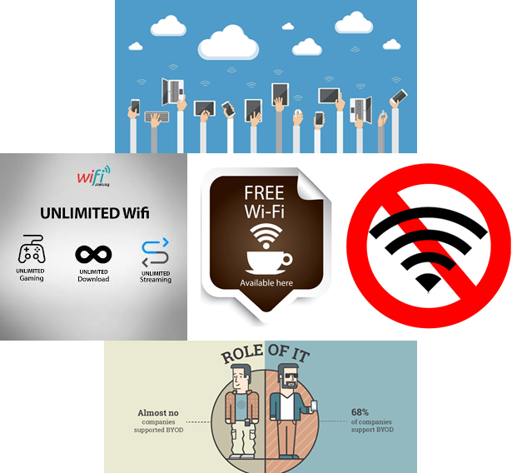
The Rise of the Cloud
At one point, computers were a tool which we used when we needed it.
Now computers are a tool which enables our lives.
Signal presence, signal strength, the cost of data, and the available bandwidth have further altered the world we live in.

Slide 22
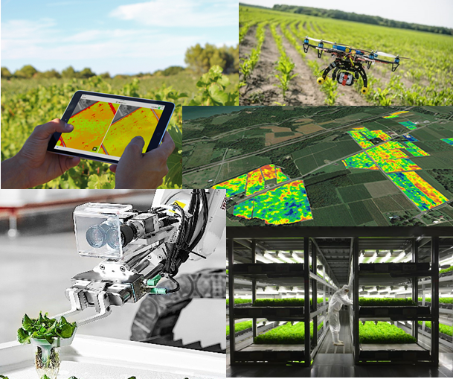
Digital Farming?
Even in some very manual job markets computers and computer-run systems are coming forward.
While digital farming is still in its infancy, it is becoming more efficient to let computers make the decisions and do much of the manual labor.
Consider how out of touch an Amish farmer looks for not using a tractor.
How out of place might a tractor look compared with a robot fleet?

Slide 23
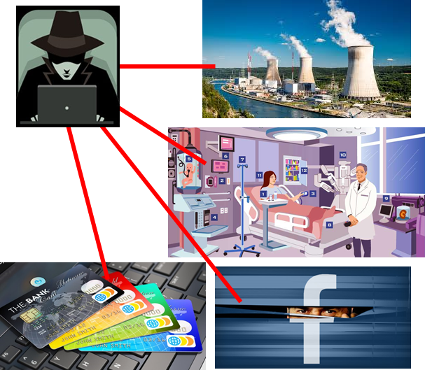
Concerns?
All of these changes create opportunities for harm.
Malicious hackers
Loss of privacy
Inhuman organization
We are in the unique position to quickly evolve a new environment for ourselves.
Are we prepared?

Slide 24
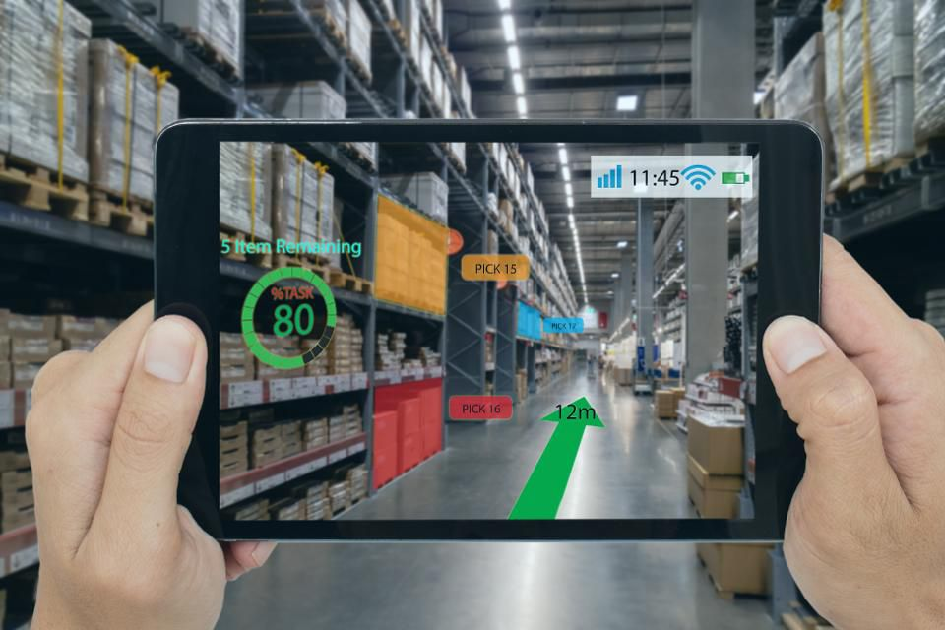
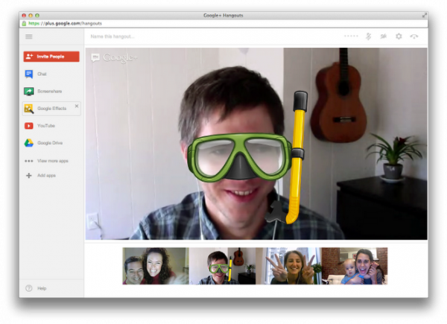
For the Future?
Augmented Reality is the newest indication of technology’s future.
As we continue to blur the line between the physical world and the digital one what else will we bring into our lives?
To what degree will our digit lives become our real lives? To what degree will our real lives become less real or more digital?

Slide 25
For the Exam / Homework
Work out a pseudocode program with registers
Understand the effects of scaled systems on:
Memory
Network
Processors
Be ready to give/critique examples of the rise of computing in human life.
What is the current state?
What might the future hold?
What concerns do you have?

